Slide 1
Election-Related Disinformation 3rd Edition

Slide 2
Secrecy of voting
Voter mobilization
Reasons for high support

Slide 3
Disinformation about the Violation of Secrecy

Slide 4
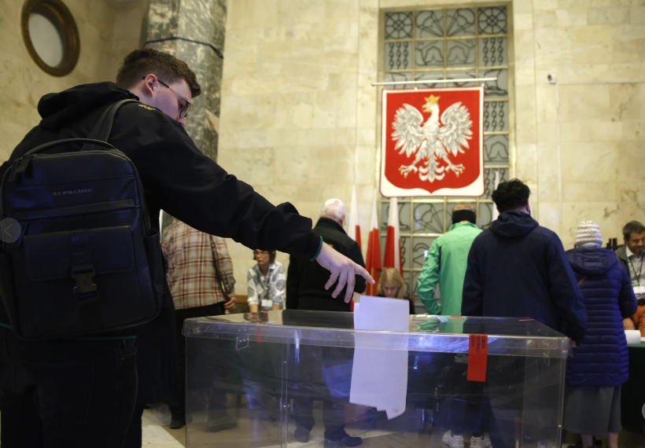
Polish Parliamentary Elections 2020
Transparent box
Ballot papers without envelopes

Slide 5
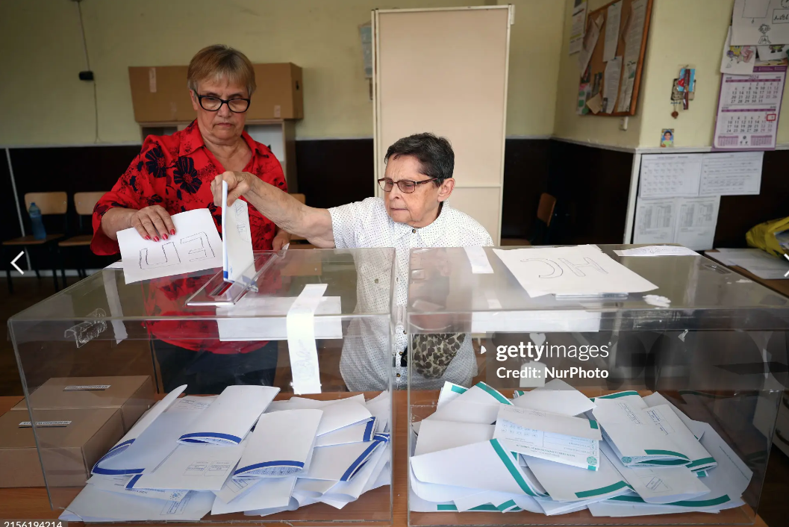
Bulgarian Parliamentary Elections
2024
Transparent box
Ballot papers without envelopes

Slide 6
Lithuanian Parliamentary Elections 13.10.2024
Semi-transparent box
Ballot papers without envelopes

Slide 7
Moldovan Presidential Elections 3.11.2024
Semi-transparent box
Ballot papers without envelopes

Slide 8
Disinformation
Mobilization of Voters

Slide 9
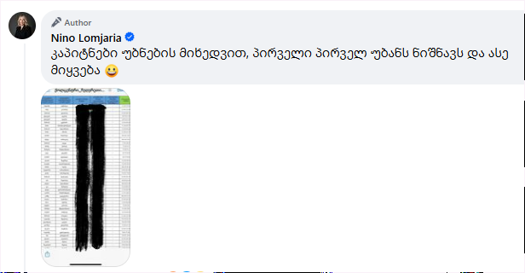
Fascist Campaign on Social Media
The former Public Defender is sharing personal information in a context that marks individuals as targets for attack

Slide 10
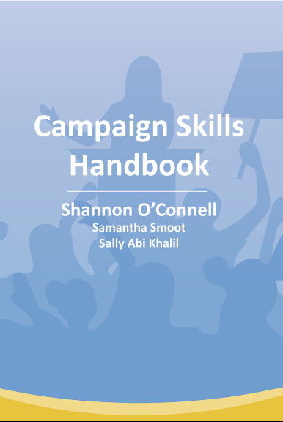
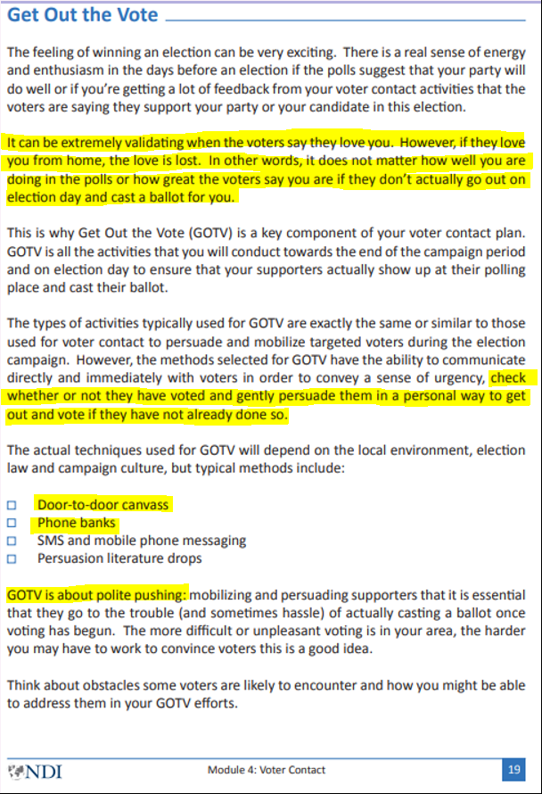
NDI’s Guide on Organizing an Election Campaign
Being loved by voters is not enough if they only love you from their homes
It does not matter how good your ratings are in the polls if your voters do not go out on election day
Check if they have voted, and persuade them to go out and vote if they haven’t done so yet

Slide 11
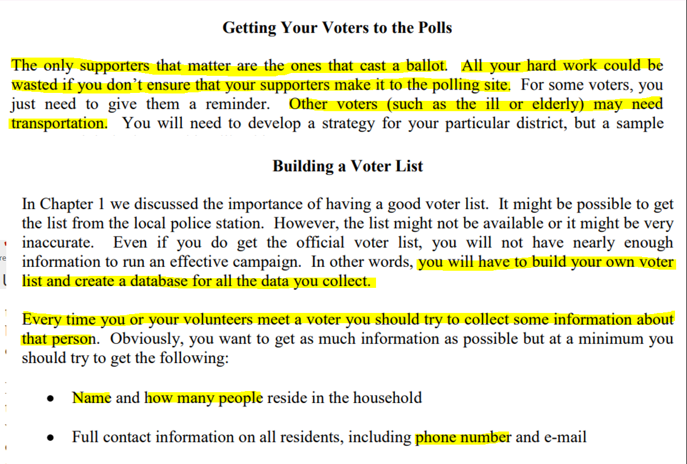
IRI’s Guide on Organizing an Election Campaign
The supporter who actually votes is crucial. Your efforts may be wasted if you do not ensure that your voters turn out on election day
Create your own database of voters (name, phone number, etc.)
One week before the election: contact all supporters and remind them to go vote
On election day: reach out and assist them in getting to the polling station

Slide 12
Disinformation about the Reasons for High Support

Slide 13
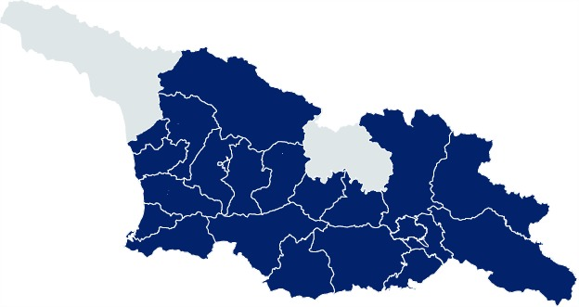
Delegates
Delegates in every district
Door-to-door
Regional events
Delegate activity
5,048 meetings in 50 days
100 meetings per day
170 meetings per delegate

Slide 14
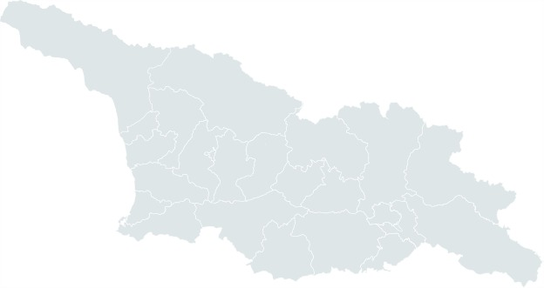
Delegates
The opposition did not have a single delegate
They had no candidates from the regions or ethnic groups on their party lists
They ran almost no campaign in the region
They relied on television and foreigners
Meanwhile, the opposition’s
Visits abroad:
The United States
Belgium
Norway
Sweden
Poland
Portugal
Italy

Slide 15
Results
Ninotsminda | 88,19%
Akhalkalaki | 87,79%
Sachkhere | 84,34%
Bolnisi | 81,43%
Marneuli | 79,62%
Lentekhi | 75,41%
Dmanisi | 75,38%
Kazbegi | 72,54%
Mestia | 72,54%
Tsalka | 71,55%
Support exceeded 50% in 60 out of 64 municipalities (94%)

Slide 16
Disinformation about Pressure on Voters
Turnout
Georgia - 58,9% (+2,8%)
Tbilisi - 61,5% (+6,7%)
Lowest turnout
Highest turnout
1 | Marneuli | 43,29% | -4,0%
2 | Gardabani | 44,80% | -4,4%
3 | Tsalka | 46,75% | 0,6%
4 | Bolnisi | 46,97% | -2,5%
5 | Zugdidi | 47,59% | 0,7%
1 | Keda | 76,05% | 3,6%
2 | Aspindza | 73,28% | 1,9%
3 | Kharagauli | 72,42% | 2,9%
4 | Ambrolauri | 70,35% | 3,0%
5 | Adigeni | 69,75% | -2,0%

Slide 18
Complaint Statistics

Slide 19
Complaint Statistics
At 3,111 precincts, 25,000 opposition commission members wrote a total of 9 differing opinions.
Out of the 3,111 precincts, 366 were recounted by random selection, with only 32 undergoing minor corrections.

Slide 20
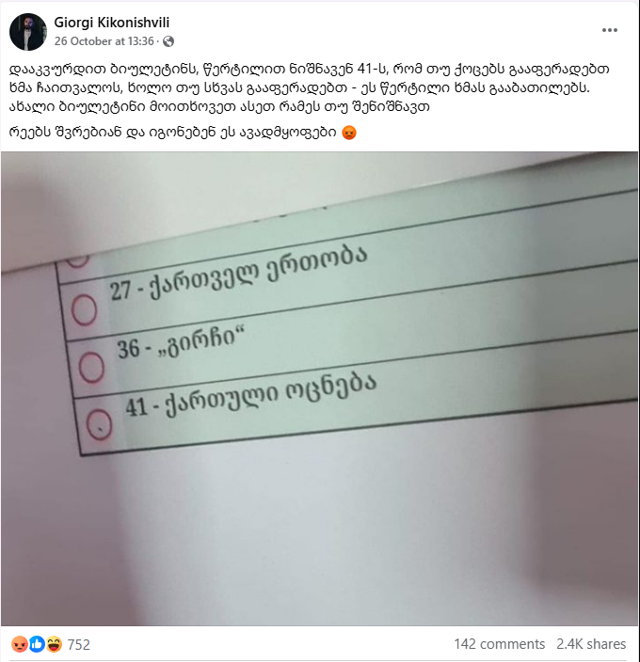
No such ballots were found during the recount, and no complaints were filed on this matter.

